Slide 1

Recursive and Recursively Enumerable Languages. Properties of Recursive and Recursively Enumerable Languages. + Decidability and Undecidability, Halting Problem, Rice’s Theorem, Greibach’s Theorem, Post Correspondence Problem, Context Sensitivity and Linear Bound Automata.
Module 6.1 and 6.2

Slide 2
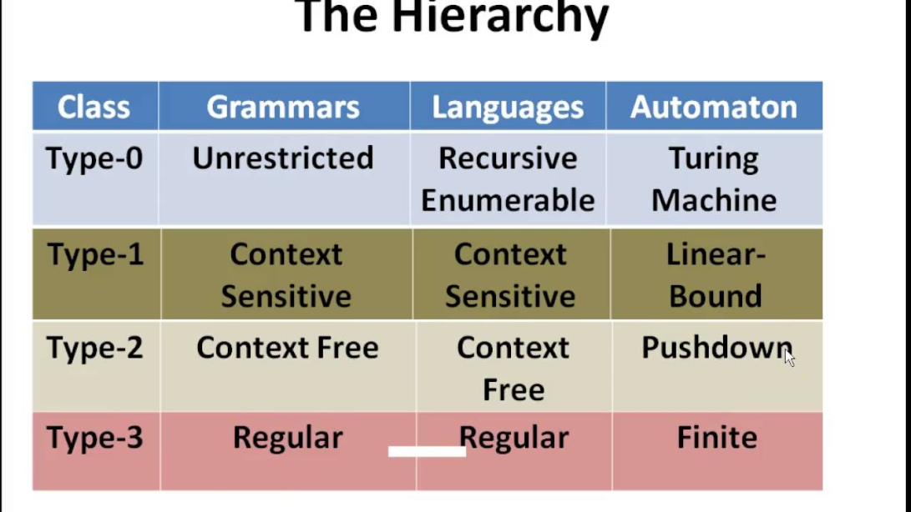
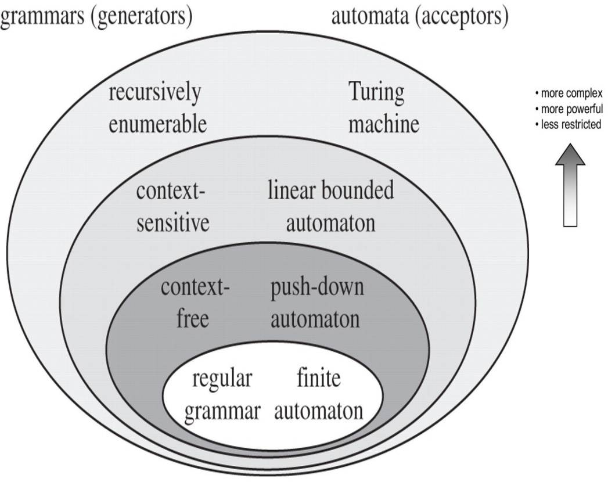
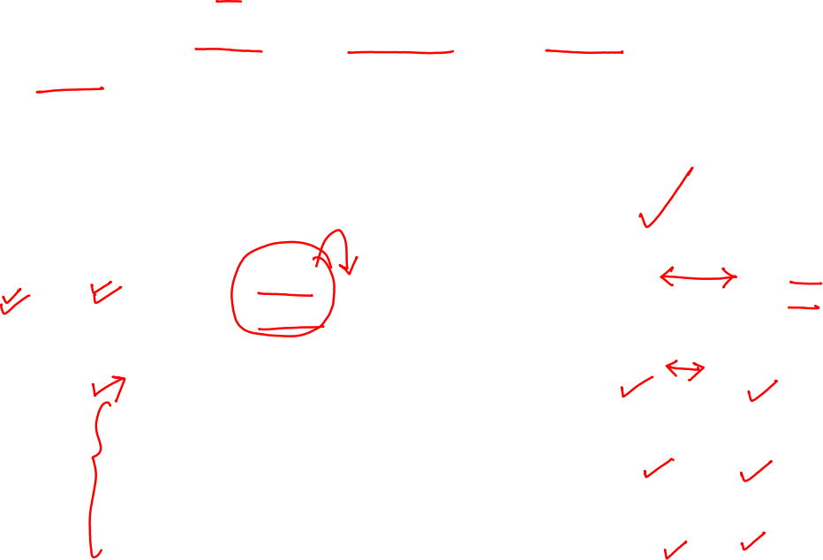
Turing Machine
Turing Machine was invented by Alan Turing in 1936
Accepts Recursive Enumerable Languages (generated by Type-0 Grammar).

Slide 3

Recursive Enumerable (RE) or Type -0 Language
RE languages or type-0 languages are generated by type-0 grammars.

Slide 4




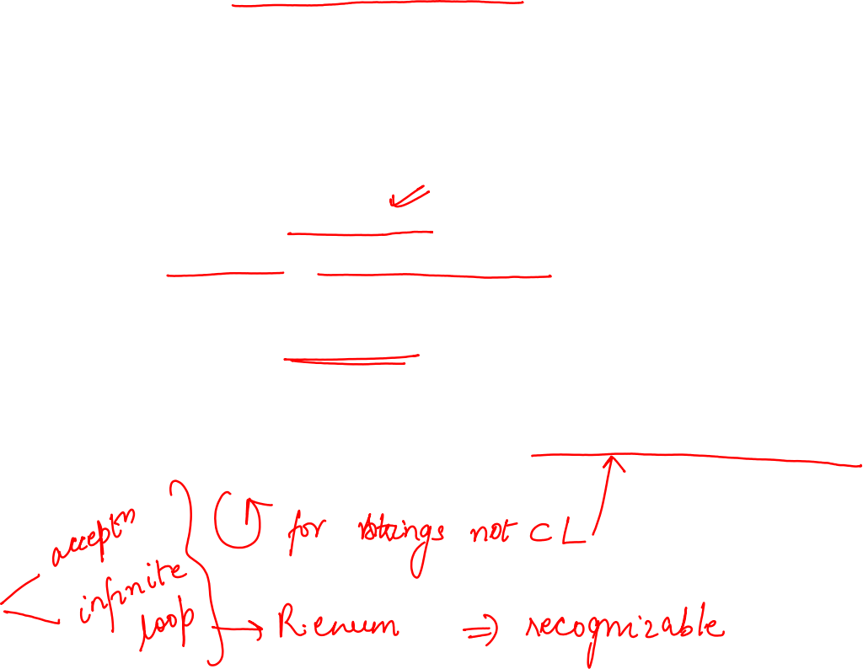

Recursive Enumerable (RE) or Type -0 Language
An RE language can be accepted or recognized by Turing machine which means :
It will enter into final state for the strings of language and may or may not enter into rejecting state for the strings which are not part of the language.
It means TM can loop forever for the strings which are not a part of the language.
RE languages are also called as Turing recognizable languages.

Slide 5


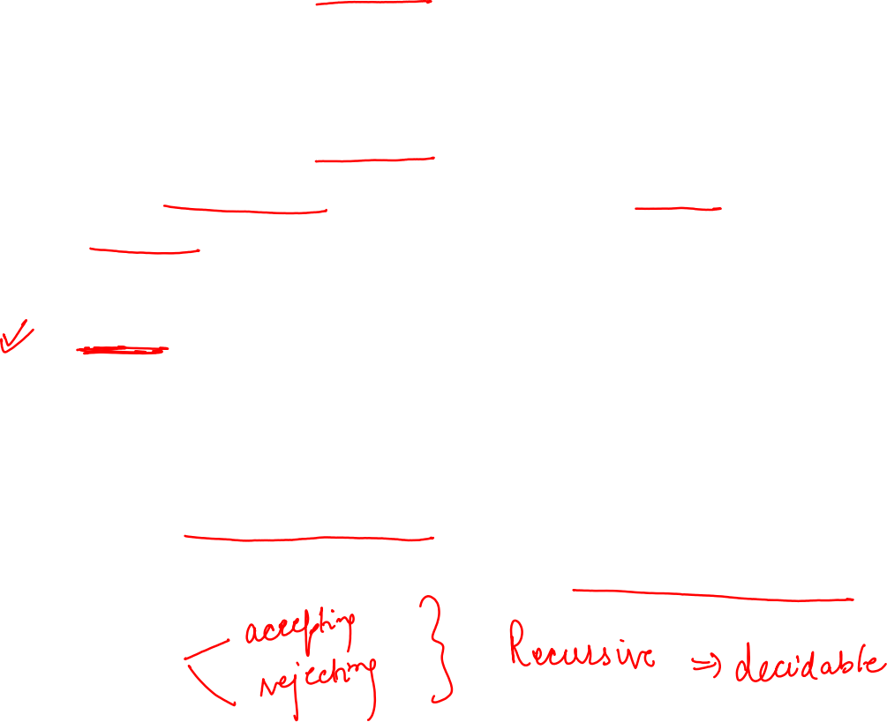



Recursive Language (REC)
A recursive language (subset of RE) can be decided by Turing machine which means :
It will enter into final state for the strings of language and rejecting state for the strings which are not part of the language.
E.g.
L= {a^{n}b^{n}c^{n}|n>=1} is recursive
We can construct a turing machine which will move to final state if the string is of the form a^{n}b^{n}c^{n} else move to non-final state.
So the TM will always halt in this case.
REC languages are also called as Turing decidable languages.

Slide 6





Some Confusing Terms
Language Decided
We say a TM decide a language L
if it accepts all strings in L and rejects all strings not in L.
Language Recognized
We say a TM recognizes language L if it accepts all strings in L. It may or may not reject any string not in L
i.e., it might go into an infinite loop in case of non-acceptance. (It will never accept a string not in L)

Slide 7

Nomenclature
Recursive Enumerable (RE) languages =Turing recognizable languages.
Recursive (REC) languages = Turing decidable languages.

Slide 8
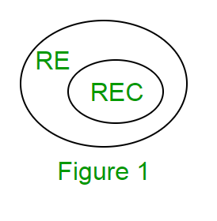
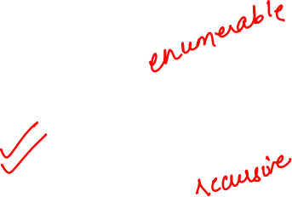
Recursive Language (REC)
The relationship between RE and REC languages can be shown in Figure 1.

Slide 9
Closure Properties of Recursive Languages
Union:
If L1 and If L2 are two recursive languages, their union L1∪L2 will also be recursive because if TM halts for L1 and halts for L2, it will also halt for L1∪L2.

Slide 10

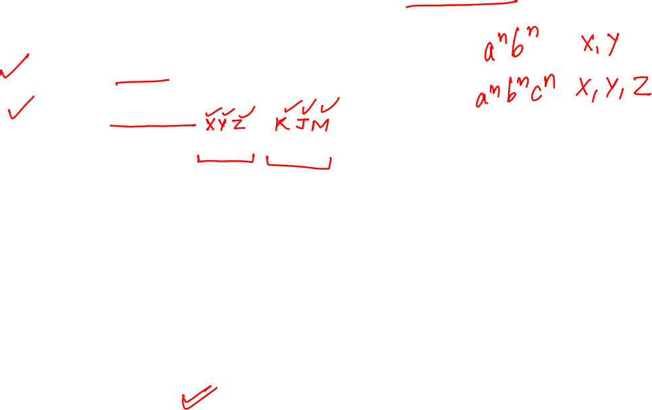
Closure Properties of Recursive Languages
Concatenation:
If L1 and If L2 are two recursive languages, their concatenation L1.L2 will also be recursive.
For Example:
L1= {a^{n}b^{n}c^{n}|n>=0}
L2= {d^{m}e^{m}f^{m}|m>=0}
L3= L1.L2 = {a^{n}b^{n}c^{n}d^{m} e^{m}f^{m}|m>=0 and n>=0} is also recursive.
L1 says n no. of a’s followed by n no. of b’s followed by n no. of c’s.
L2 says m no. of d’s followed by m no. of e’s followed by m no. of f’s.
Their concatenation first matches no. of a’s, b’s and c’s and then matches no. of d’s, e’s and f’s. So it can be decided by TM.

Slide 11


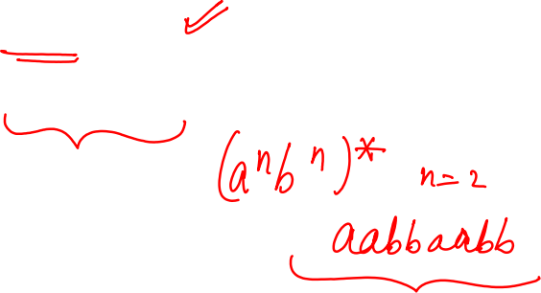
Closure Properties of Recursive Languages
Kleene Closure:
If L1 is recursive, its Kleene closure L1* will also be recursive.
For Example:
L1= {a^{n}b^{n}c^{n}|n>=0}
L1*= { a^{n}b^{n}c^{n}||n>=0}* is also recursive.

Slide 12



Closure Properties of Recursive Languages
Intersection :
If L1 and If L2 are two recursive languages, their intersection L1 ∩ L2 will also be recursive.
Example:
L1= {a^{n}b^{n}c^{n}d^{m}|n>=0 and m>=0}
L2= {a^{n}b^{n}c^{n}d^{n}|n>=0 and m>=0}
L3=L1 ∩ L2 = { a^{n}b^{n}c^{n}d^{n} |n>=0} will be recursive.
L1 says n no. of a’s followed by n no. of b’s followed by n no. of c’s and then any no. of d’s.
L2 says any no. of a’s followed by n no. of b’s followed by n no. of c’s followed by n no. of d’s.
Their intersection says n no. of a’s followed by n no. of b’s followed by n no. of c’s followed by n no. of d’s.
So it can be decided by turing machine, hence recursive.

Slide 13




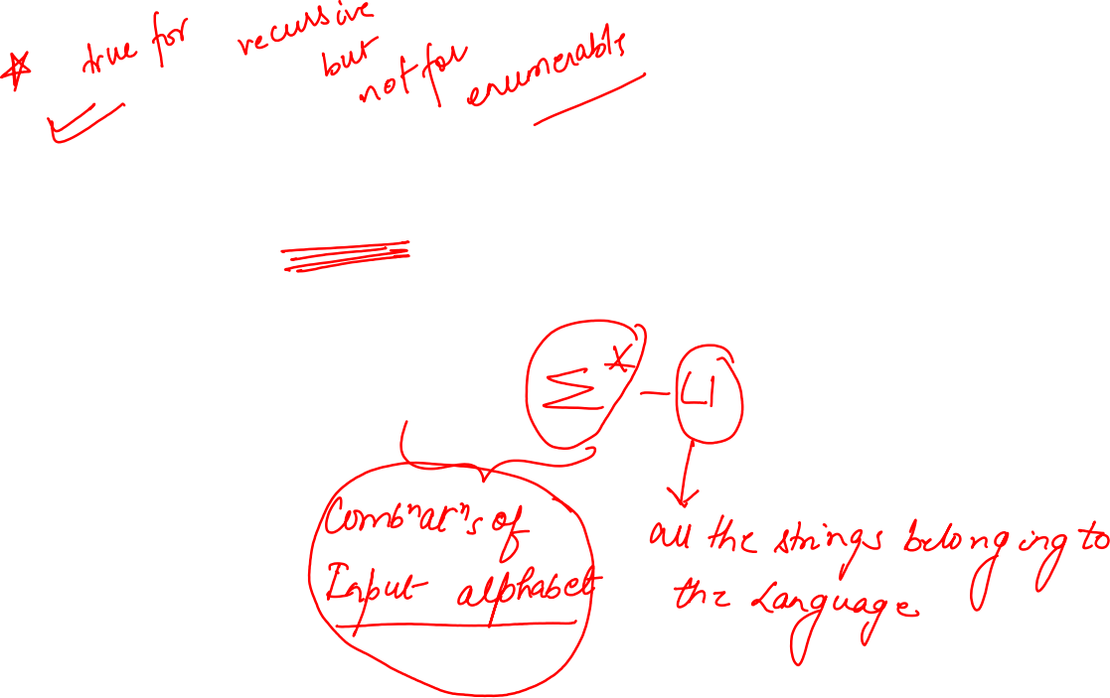



Closure Properties of Recursive Languages
Complement:
Similarly, complement of recursive language L1 which is ∑*-L1, will also be recursive.

Slide 14
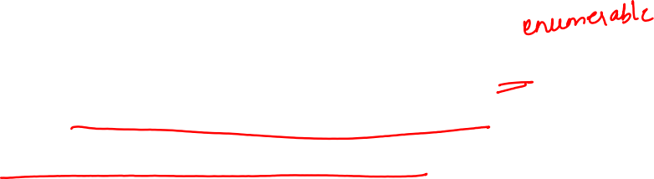
Closure Properties of Recursive Enumerable Languages
Complement:
Note: As opposed to REC languages, RE languages are not closed under complementation which means complement of RE language need not be RE

Slide 15

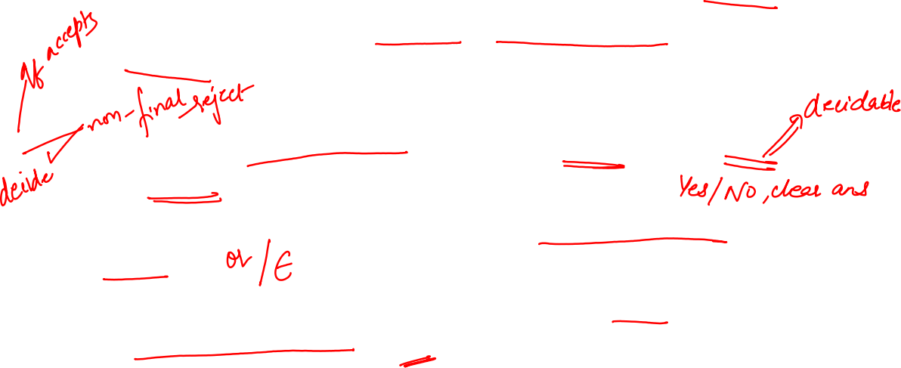
Decidability and Undecidability
Decidable language –
A decision problem P is said to be decidable (i.e., have an algorithm) if the language L of all yes instances to P is decidable.
Example-
(Acceptance problem for DFA) Given a DFA does it accept a given word?
(Emptiness problem for DFA) Given a DFA does it accept any word?
(Equivalence problem for DFA) Given two DFAs, do they accept the same language?
https://www.geeksforgeeks.org/decidability-and-undecidability-in-toc/

Slide 16

Decidability and Undecidability
Undecidable language –
A decision problem P is said to be undecidable if the language L of all yes instances to P is not decidable
or
A language is undecidable if it is not decidable.
An undecidable language maybe a partially decidable language but not decidable.
If a language is not even partially decidable , then there exists no Turing machine for that language.

Slide 17
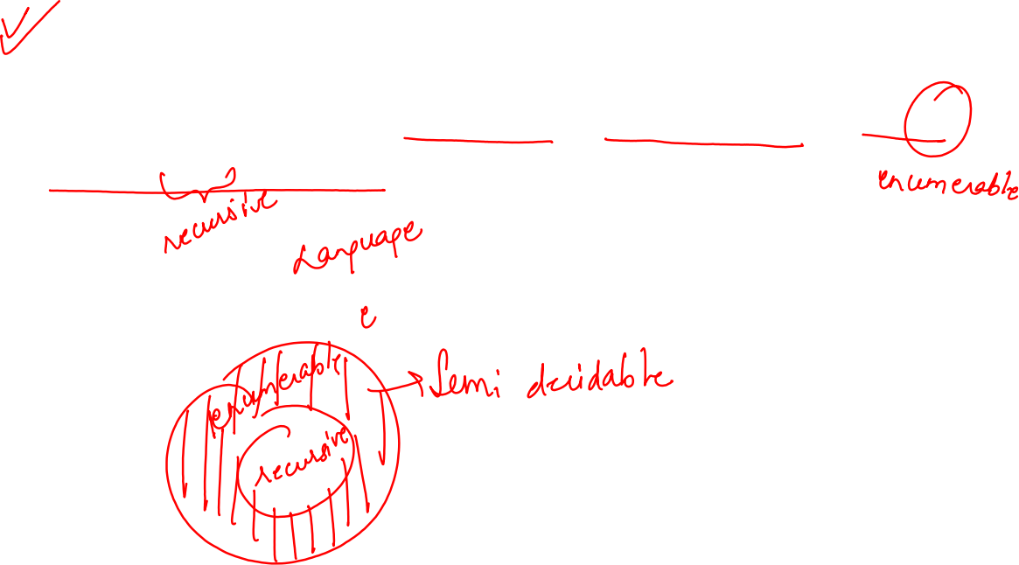
Decidability and Undecidability
Partially decidable or Semi-Decidable Language –
A decision problem P is said to be semi-decidable (i.e., have a semi-algorithm) if the language L of all yes instances to P is RE but not REC language.

Slide 18


The Halting problem
Given a program/algorithm will ever halt or not?

Slide 19

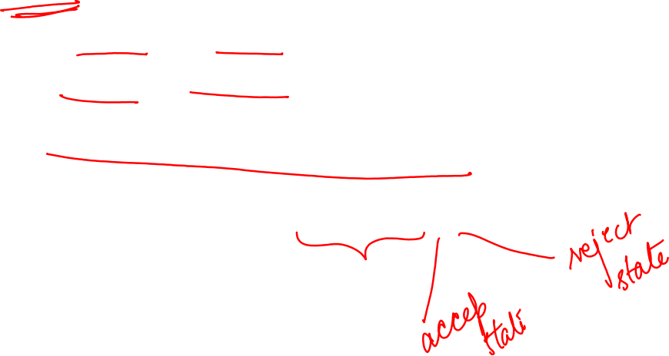
The Halting problem
Given a program/algorithm will ever halt or not?
Halting means that the program on certain input will
accept it and halt or
reject it and halt and
it would never go into an infinite loop.
Basically halting means terminating.

Slide 20
The Halting problem
Can we have an algorithm that will tell that the given program will halt or not?
In terms of Turing machine, will it terminate when run on some machine with some particular given input string.

Slide 21

The Halting problem
The answer is no
We cannot design a generalized algorithm which can appropriately say that given a program will ever halt or not?
The only way is to run the program and check whether it halts or not.

Slide 22
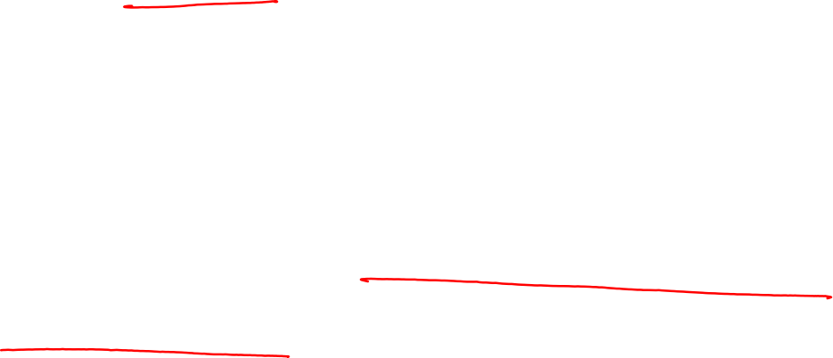
The Halting problem
We can refrain the halting problem question in such a way also:
Given a program written in some programming language(c/c++/java) will it ever get into an infinite loop(loop never stops) or will it always terminate(halt)?
This is an undecidable problem because we cannot have an algorithm which will tell us whether a given program will halt or not in a generalized way i.e by having specific program/algorithm.
The best possible way is to run the program and see whether it halts or not.

Slide 23



Nomenclature revisited
Recursive Enumerable (RE) languages =Turing recognizable languages.
Recursive (REC) languages = Turing decidable languages.

Slide 24








The Rice Theorem
Part 1 (For some undecidable languages)
Any non-trivial property of the LANGUAGE recognizable by a Turing machine (recursively enumerable language) is undecidable
Part 2 (For some unrecognizable language)
Any non-monotonic property of the LANGUAGE recognizable by a Turing machine (recursively enumerable language) is unrecognizable
https://gatecse.in/rices-theorem/

Slide 25

The Rice Theorem
A property is called to be trivial if either it is not satisfied by any recursively enumerable languages, or if it is satisfied by all recursively enumerable languages.
A non-trivial property is satisfied by some recursively enumerable languages and are not satisfied by others.
https://www.tutorialspoint.com/automata_theory/rice_theorem.htm

Slide 26
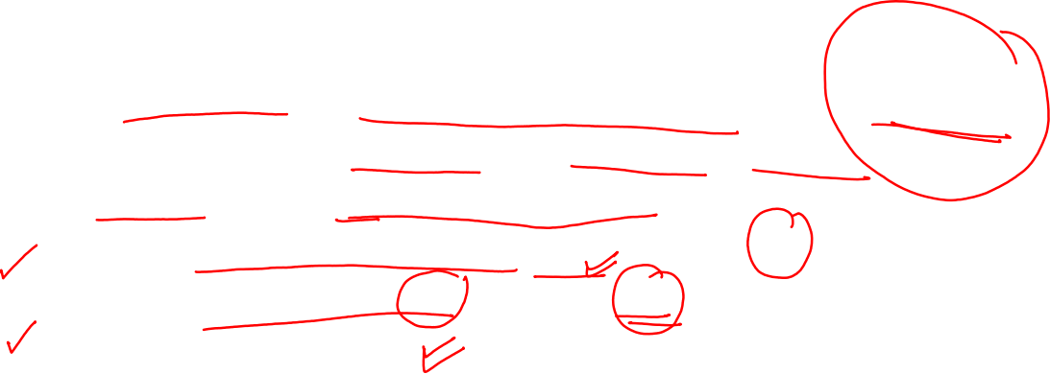
The Rice Theorem
For a property of recursively enumerable set to be non-trivial, there should exist at least two recursively enumerable languages, (hence two Turing machines),
The property holding for one (Tyes being its TM) and not holding for the other (Tno being its TM).
https://gatecse.in/rices-theorem/

Slide 27
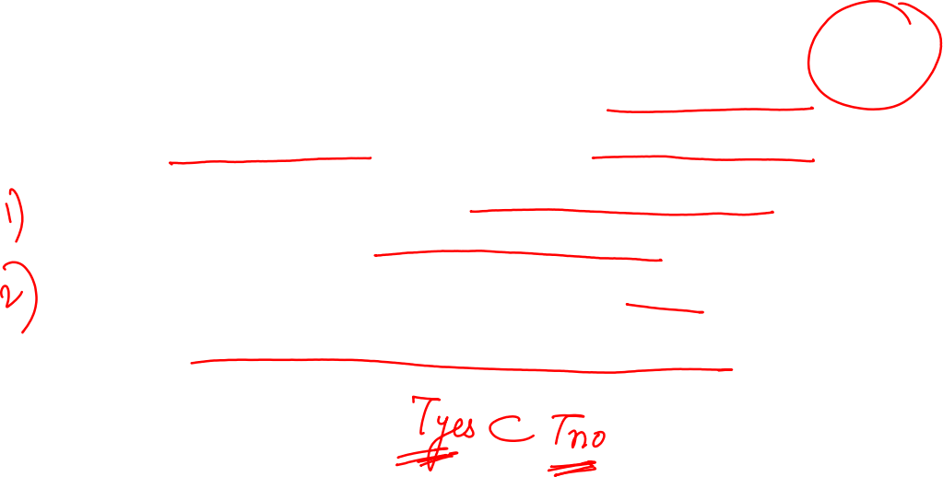
The Rice Theorem
For a property of recursively enumerable set to be non-monotonic, there should exist at least two recursively enumerable languages (hence two Turing machines),
The property holding for one (Tyes being its TM) and not holding for the other (Tno being its TM) and
The property holding set (language of Tyes) must be a proper subset of the set not having the property (language of Tno).
https://www.tutorialspoint.com/automata_theory/rice_theorem.htm

Slide 28
Post Correspondence Problem
A popular undecidable problem
Introduced by Emil Leon Post in 1946.
It is simpler than Halting Problem.
https://www.geeksforgeeks.org/post-correspondence-problem/

Slide 29
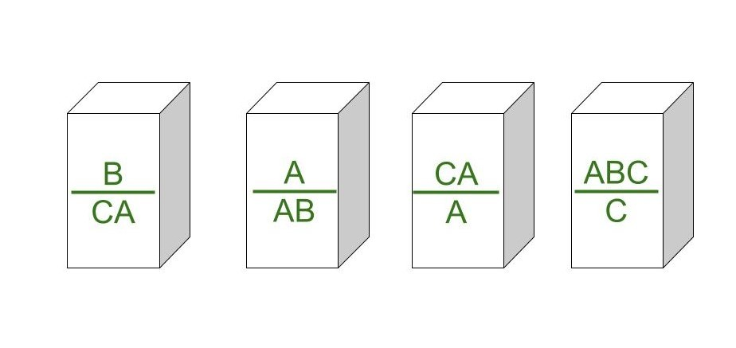
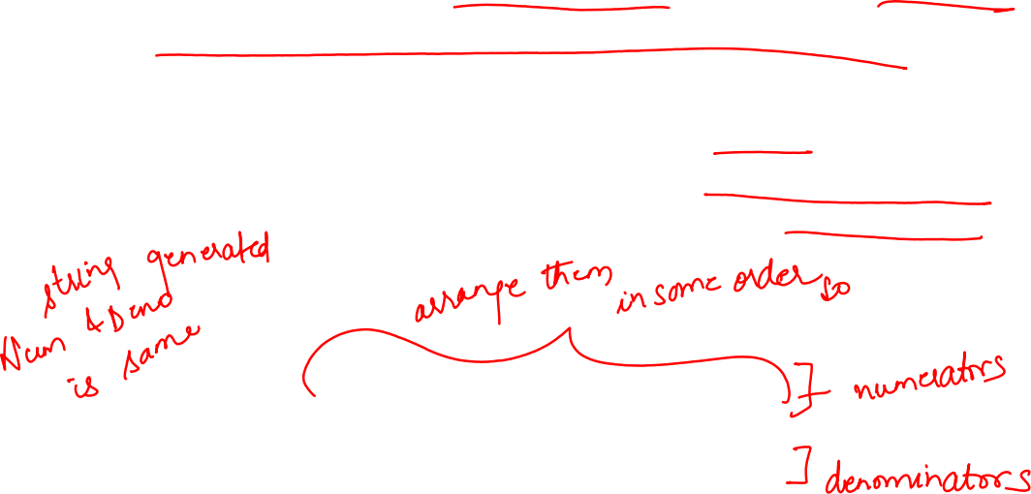
Post Correspondence Problem
In this problem we have N number of Dominos (tiles).
The aim is to arrange tiles in such order that string made by Numerators is same as string made by Denominators.
In simple words, lets assume we have two lists both containing N words, aim is to find out concatenation of these words in some sequence such that both lists yield same result.

Slide 30
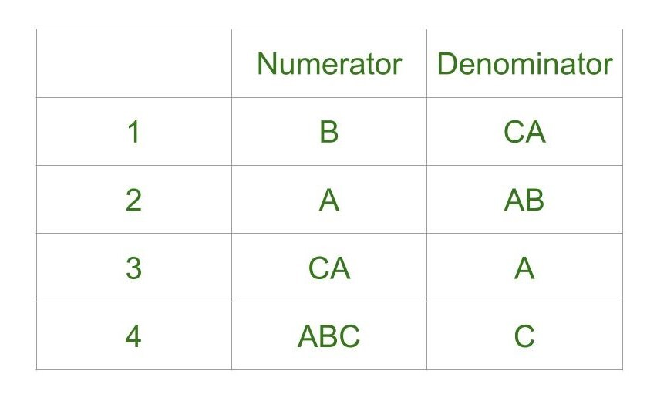

Post Correspondence Problem
Post Correspondence Problems can be represented in two ways:
1. Domino’s Form :
2. Table Form :

Slide 31

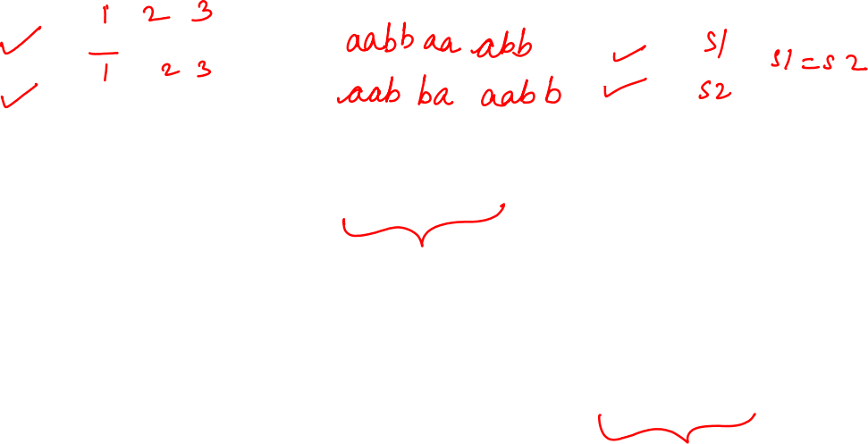
Post Correspondence Problem-1
Let’s try understanding this by taking two lists A and B
A=[aa, bb, abb]
B=[aab, ba, b]
Now for sequence 1, 2, 1, 3
First list will yield aabbaaabb
Second list will yield same string aabbaaabb.
So the solution to this PCP becomes 1, 2, 1, 3.
https://www.geeksforgeeks.org/post-correspondence-problem/

Slide 32
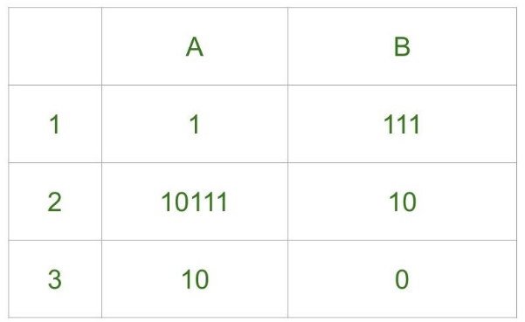
Post Correspondence Problem-2
Solve the Post Correspondance Problem for the Dominos given below;
https://www.geeksforgeeks.org/post-correspondence-problem/

Slide 33
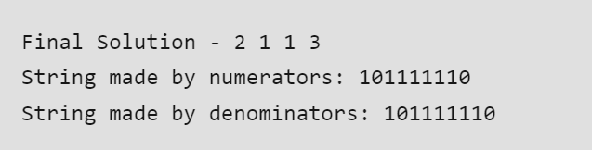
Post Correspondence Problem-2
Solve the Post Correspondance Problem for the Dominos given below;
https://www.geeksforgeeks.org/post-correspondence-problem/

Slide 34
Formal Definition of Context Sensitive Grammar
A context sensitive grammar G = ( V, Σ, P, S), where
V is a set of non-terminal symbols
Σ is a set of terminal symbols
S is the start symbol, and
P is a set of production rules, of the form αAβ → αγβ , where A in V, α, β ∈ (V ∪ Σ) and γ ∈ (V ∪ Σ)⁺

Slide 35
Formal Definition of Context Sensitive Grammar
P is a set of production rules, of the form αAβ → αγβ , where A in V, α, β ∈ (V ∪ Σ) and γ ∈ (V ∪ Σ)⁺
With γ nonempty
To derive the empty string, S → Λ must also be included in the productions, with S not occurring on the right-hand side of any production.

Slide 36

Formal Definition of Context Sensitive Grammar
During derivation non-terminal A will be changed to γ only when it is present in the context of α and β.
αAβ → αγβ

Slide 37
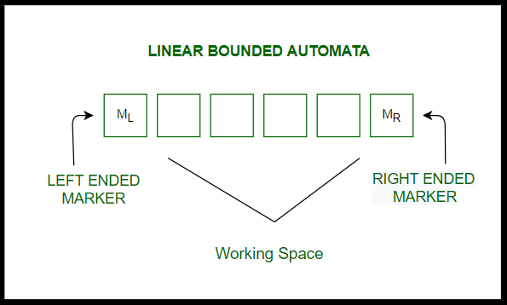
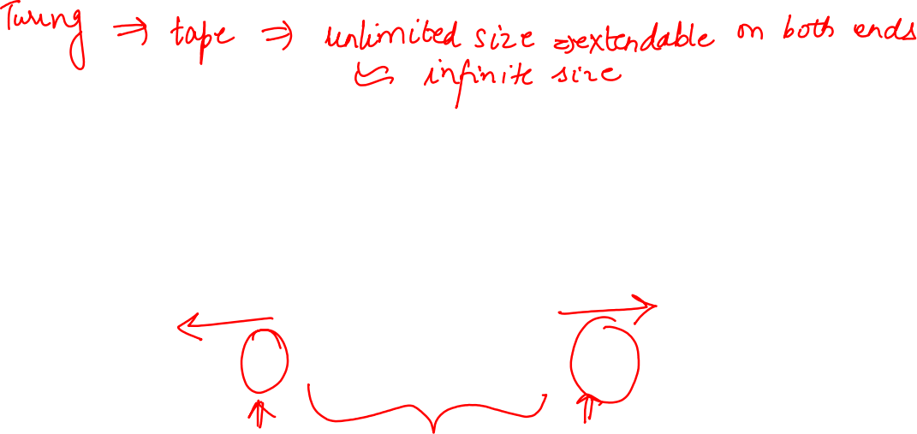
Linear Bound Automata
Linear Bounded Automata (LBA) is a single tape Turing Machine with two special tape symbols call them left marker < and the right marker >.

Slide 38
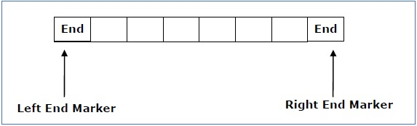
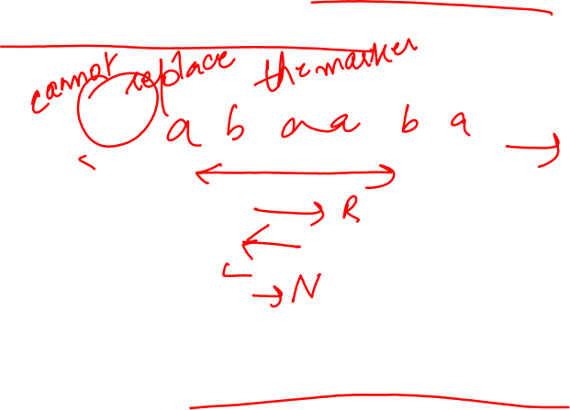
Linear Bound Automata
The transitions neither move to the left of the left end marker nor to the right of the right end marker of the tape.
The transitions should satisfy these conditions:
It should not replace the marker symbols by any other symbol.
It should not write on cells beyond the marker symbols.

Slide 39
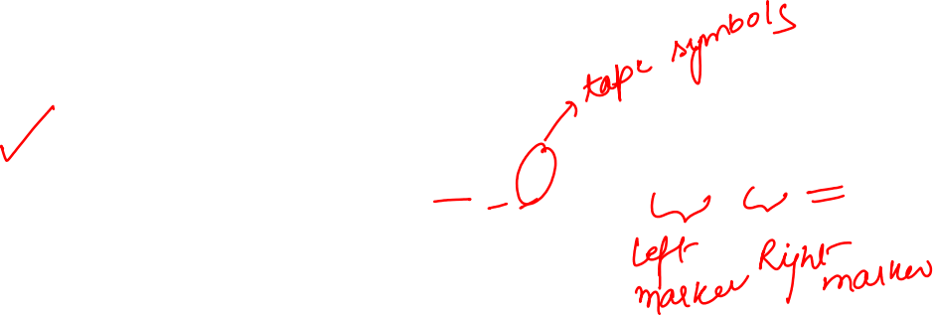
Formal Definition of Linear Bound Automata
Formally Linear Bounded Automata is a non-deterministic Turing Machine , M = ( Q, Σ, Γ, δ, q0, ML, MR, F)
Q is set of all states
Σ is set of all terminals
Γ is set of all tape symbols, Σ ⊂ Γ
δ is set of transitions
q0 is the initial state
ML is left marker = Left bound of tape
MR is right marker =Right bound of tape where MR !=ML
F is finite set of final states

Slide 40

Formal Definition of Linear Bound Automata
δ is a transition function which maps each pair (state, tape symbol) to (state, tape symbol, {L,R,N})
https://www.tutorialspoint.com/automata_theory/linear_bounded_automata.htm

Slide 41

Greibach's theorem
In theoretical computer science, in particular in formal language theory, Greibach's theorem states that certain properties of formal language classes are undecidable.
It is named after the computer scientist Sheila Greibach, who first proved it in 1963.
https://www.tutorialspoint.com/automata_theory/linear_bounded_automata.htm

Slide 43
Greibach's theorem
Formal statement of the theorem
Considers a set C of formal languages over an alphabet Σ∪{#} such that
each language in C has a finite description,
each regular language over Σ∪{#} is in C
given descriptions of languages L1, L2 ∈ C and of a regular language R ∈ C, a description of the products L1R and RL1, and of the union L1∪L2 can be effectively computed, and
it is undecidable for any member language L ∈ C with L ⊆ Σ* whether L = Σ*.
https://www.tutorialspoint.com/automata_theory/linear_bounded_automata.htm

Slide 44
Greibach's theorem
Formal statement of the theorem
Let P be any nontrivial subset of C that contains all regular sets over Σ∪{#} and is closed under quotient by each single symbol in Σ∪{#}.
Then the question whether L ∈ P for a given description of a language L ∈ C is undecidable.
https://www.tutorialspoint.com/automata_theory/linear_bounded_automata.htm

